Slide 1

INSTITUTE - UIE
DEPARTMENT- ACADEMIC UNIT-2
Bachelor of Engineering (Computer Science & Engineering)
Subject Name: Introduction to Problem Solving
Code:22CSH-101
Bitwise Operator and Type Casting
DISCOVER . LEARN . EMPOWER

Slide 2
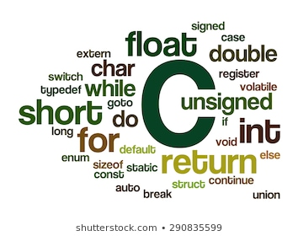
Introduction to Problem Solving
Course Objectives
The course aims to provide exposure to problem-solving through programming.
The course aims to raise the programming skills of students via logic building capability.
With knowledge of C programming language, students would be able to model real world problems.

Slide 3



Course Outcomes
CO Number | Course Outcome
CO1 | Remember the concepts related to fundamentals of C language, draw flowcharts and write algorithm/pseudocode.
CO2 | Understand the way of execution and debug programs in C language.
CO3 | Apply various constructs, loops, functions to solve mathematical and scientific problem.
CO4 | Analyze the dynamic behavior of memory by the use of pointers.
CO5 | Design and develop modular programs for real world problems using control structure and selection structure.

Slide 4
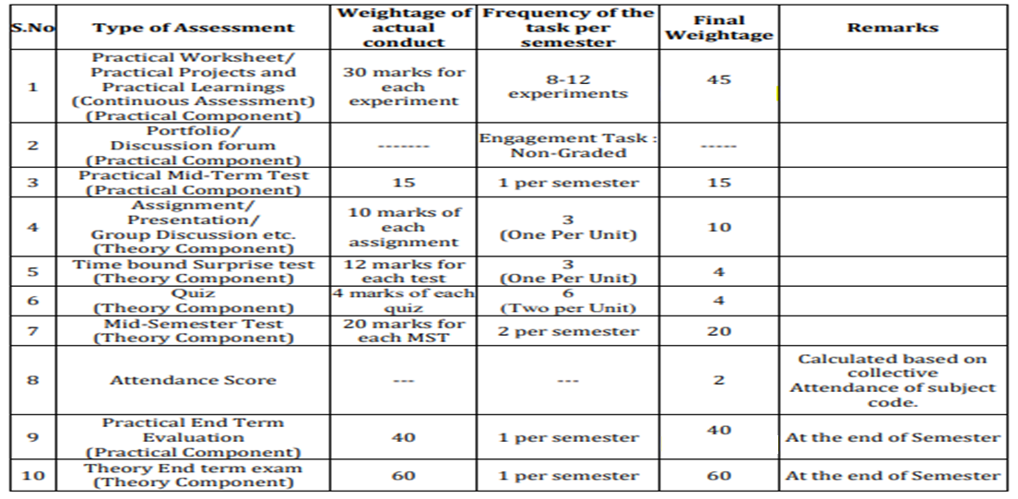
Scheme of Evaluation

Slide 5
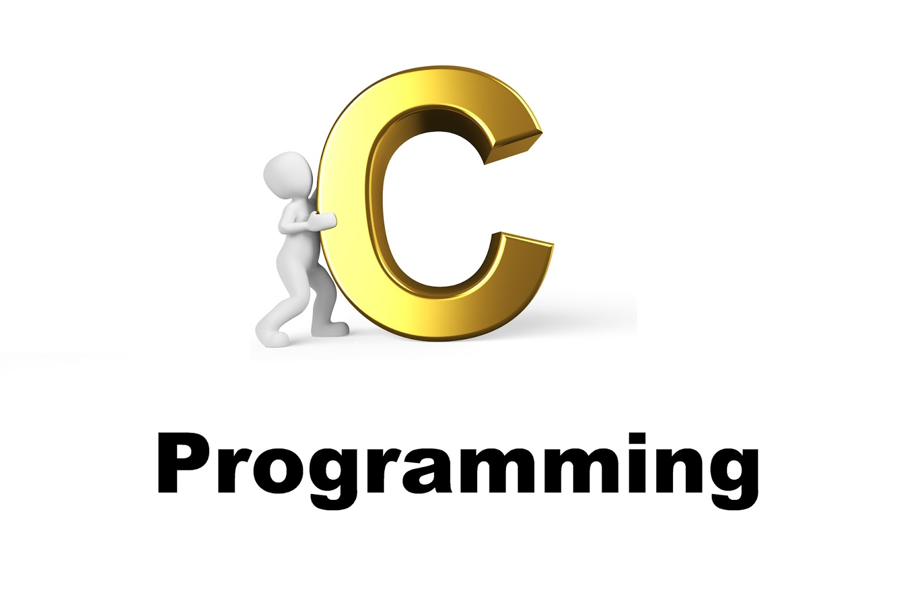
CONTENTS
Space for visual (size 24)
Bitwise operator
Type Casting/ Type Conversion
Notes:
Computer in the diagram is 3rd generation computer. The period of third generation was from 1965-1971. The computers of third generation used Integrated Circuits (ICs) in place of transistors. A single IC has many transistors, resistors, and capacitors along with the associated circuitry. The main features of third generation are −
IC used
More reliable in comparison to previous two generations
Smaller size
Generated less heat
Faster
Lesser maintenance
Costly
AC required
Consumed lesser electricity
Supported high-level language

Slide 6
Operators
An operator is a symbol that tells the compiler to perform certain mathematical or logical manipulations.
Operators are used in program to manipulate data and variables. The data items that operators act upon are called operands.
Some operators require two operands, while others act upon only one operand. The operators are classified into unary, binary and ternary depending on whether they operate on one, two or three operands respectively.

Slide 7
Bitwise Operator
In arithmetic-logic unit (which is within the CPU), mathematical operations like: addition, subtraction, multiplication and division are done in bit-level.
Decimal values are converted into binary values which are the sequence of bits and bit wise operators work on these bits.
Table1: Truth table of Bitwise operations
X | Y | X|Y | X&Y | X^Y
0 | 0 | 0 | 0 | 0
0 | 1 | 1 | 0 | 1
1 | 0 | 1 | 0 | 1
1 | 1 | 1 | 1 | 0

Slide 8
Bitwise Operator
Bitwise operators are as follows:
Operator | Meaning of operator
& | Bitwise And
| | Bitwise Or
^ | Bitwise XOR
~ | Bitwise Compliment
<< | Left Shift
>> | Right Shift

Slide 9
Bitwise Operator
Bitwise AND
12 = 00001100 (In Binary)
25 = 00011001 (In Binary)
Bit Operation of 12 and 25
00001100
& 00011001
________
00001000 = 8 (In decimal)

Slide 10
Bitwise Operator
Bitwise OR
12 = 00001100 (In Binary)
25 = 00011001 (In Binary)
Bitwise OR Operation of 12 and 25
00001100
| 00011001
________
00011101 = 29 (In decimal)

Slide 11
Bitwise Operator
Bitwise XOR
12 = 00001100 (In Binary)
25 = 00011001 (In Binary)
Bitwise XOR Operation of 12 and 25
00001100
^ 00011001
________
00010101 = 21 (In decimal)

Slide 12
Bitwise Operator
Bitwise Compliment
35 = 00100011 (In Binary)
Bitwise complement Operation of 35
~ 00100011
________
11011100 = 220 (In decimal)

Slide 13
Bitwise Operator
Bitwise Right shift
212 = 11010100 (In binary)
212>>2 = 00110101 (In binary) [Right shift by two bits]
212>>7 = 00000001 (In binary)
212>>8 = 00000000
212>>0 = 11010100 (No Shift)

Slide 14
Bitwise Operator
Bitwise Left shift
212 = 11010100 (In binary)
212<<1 = 110101000 (In binary) [Left shift by one bit]
212<<0 =11010100 (Shift by 0)
212<<4 = 110101000000 (In binary) =3392(In decimal)

Slide 15
Bitwise Operator
#include <stdio.h>
int main()
{
int a = 12, b = 25; //12=00001100,25=00011001
printf("Output = %d\n", a&b); // &=00001000=8
printf("Output = %d\n", a|b); // |=00011101=29
printf("Output = %d\n", a^b); // ^=00010101=21
printf("Output = %d\n", ~a); //~a=11110011=243=-(2's complement of 243)=-13
printf("Output = %d\n", a>>4); //00000000
printf("Output = %d", a<<4); //11000000
return 0;
}

Slide 16
TRY IT
What will be the output of the C program?
#include<stdio.h>
int main()
{
int a = 4, b = 2;
printf("a^b = %d", a^b);
return 0;
}
A. 12
B. 10
C. 8
D. 6

Slide 17
Type-Casting/Type-Conversion
The type conversion process in C is basically converting one type of data type to other to perform some operation.
The conversion is done only between those datatypes wherein the conversion is possible ex – char to int and vice versa.
It’s of two types
→Implicit Type Conversion
→Explicit Type Conversion

Slide 18
Type-Casting/Type-Conversion
→Implicit Type Conversion
This type of conversion is usually performed by the compiler when necessary without any commands by the user. Thus it is also called "Automatic Type Conversion".
The compiler usually performs this type of conversion when a particular expression contains more than one data type. In such cases either type promotion or demotion takes place.

Slide 19
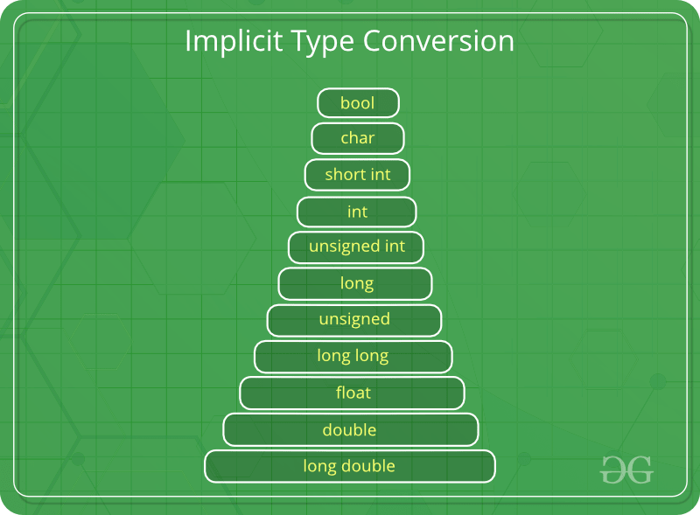
Type-Casting/Type-Conversion
→Implicit Type Conversion

Slide 20
Type-Casting/Type-Conversion
Rules:
char or short type operands will be converted to int during an operation and the outcome data type will also be int.
If an operand of type long double is present in the expression, then the corresponding operand will also be converted to long double same for the double data type.
If an operand of float type is present then the corresponding operand in the expression will also be converted to float type and the final result will also be float type.
If an operand of unsigned long int is present then the other operand will be converted to unsigned long int and the final result will also be unsigned long int.
If an operand of long int is present then the other operand will be converted to long int and the final result will also be long int.
If an operand of unsigned int is present then the other operand will be converted to unsigned int and the final result will also be unsigned int.

Slide 21
Type-Casting/Type-Conversion
→Implicit Type Conversion
Example 1
int a = 20;
double b = 20.5;
a + b;
Here, first operand is int type and other is of type double. So, as per rule 2, the variable a will be converted to double. Therefore, the final answer is double a + b = 40.500000.
Example 2
char ch='a';
int a =13;
a + ch;
Here, first operand is char type and other is of type int. So, as per rule 1, the char variable will be converted to int type during the operation and the final answer will be of type int. We know the ASCII value for ch is 97. Therefore, final answer is a + ch = 97 + 13 = 110.

Slide 22
Type-Casting/Type-Conversion
→Explicit Type Conversion
Explicit type conversion rules out the use of compiler for converting one data type to another instead the user explicitly defines within the program the datatype of the operands in the expression.

Slide 23
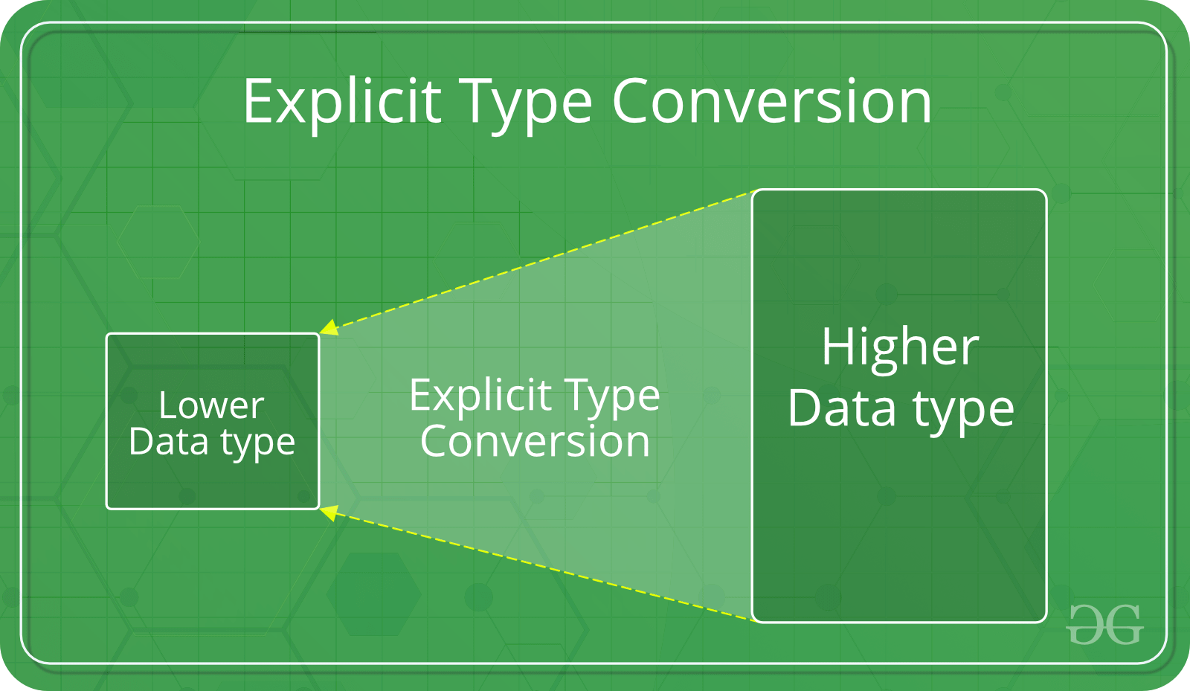
Type-Casting/Type-Conversion
→Explicit Type Conversion

Slide 24
Type-Casting/Type-Conversion
→Explicit Type Conversion Example:
Example:
double da = 4.5;
double db = 4.6;
double dc = 4.9;
//explicitly defined by user
int result = (int)da + (int)db + (int)dc;
printf("result = %d", result);
Output
result = 12

Slide 25
Summary
Keep in mind the following rules for programming practice when dealing with different data type to prevent from data loss :
Integers types should be converted to float.
Float types should be converted to double.
Character types should be converted to integer.

Slide 26
FAQ’s
Q1. Compute the sign of an integer?
Q2. Detect if two integers have opposite signs?
Q3. Write a program to check an integer is a power of 2?
Q4. How to set a particular bit in C?
Q5. When should a type cast not be used?

Slide 27
Assessment
Q1. WAP to clear a bit.
Q2. We define S to be a sequence of distinct sequential integers from 1 to n ; in other words S={1,2,3,….n}, . We want to know the maximum bitwise AND value of any two integers, a and b (where a<b ), in sequence S that is also less than a given integer, k . Complete the function in the editor so that given n and k , it returns the maximum a&b<k .
Note: The &symbol represents the bitwise AND operator.
Sample Input 0
3
5 2
8 5
2 2
Sample Output 0
1
4
0
Write the code of the above scenario that satisfies the above situation.

Slide 28
Assessment
Q 3. What will be the output of the C program?
#include<stdio.h>
int main()
{
int a = 4, b = 2;
printf("a^b = %d", a^b);
return 0;
}
A. 12
B. 10
C. 8
D. 6

Slide 29
Assessment
Q4. What will be the output of the C program?
#include<stdio.h>
int main()
{
int a = 4, b = 2;
printf("a^b = %d", a^b);
return 0;
}
A. 12
B. 10
C. 8
D. 6
Q5. [&] is the symbol of Bitwise And.
Q6. [float to char pointer] type of conversion is NOT accepted.

Slide 30
References
S.No | Title | Content link
1 | Book | Programming in C by Reema Thareja.
2 | Book | Programming with C (Schaum's Outline Series) by Byron Gottfried Jitender Chhabra, Tata McGraw Hill.
3 | Book | The C Programming Language by Brian W. Kernighan, Dennis Ritchie, Pearson education.
4 | Book | Programming in ANSI C by E. Balaguruswamy, Tata McGraw Hill.
5 | Weblink | https://www.tutorialspoint.com/cprogramming/c_operators.htm
6 | Weblink | https://www.programiz.com/c-programming
7 | Weblink | https://fresh2refresh.com/c-programming/

Slide 31
References
S.No | Title | Content link
8 | Weblink | https://www.studytonight.com/c/
9 | Weblink | https://www.javatpoint.com/c-operators
10 | Video Link | https://www.youtube.com/watch?v=MyxVAq9MifI
11 | Video Link | https://www.youtube.com/watch?v=xXBitioUzf8
12 | Online Course Link | https://www.coursera.org/
13 | Online Course Link | https://www.udemy.com/
14 | Online Course Link | https://www.niit.com/

Slide 32
THANK YOU

